Slide 1


Testing for Cypress Realworld App
QA Automation Middle Project
Abeer Altlalka
B.Sc in Software Engineering
QA Automation Developer

Slide 2

About the Website

Slide 3
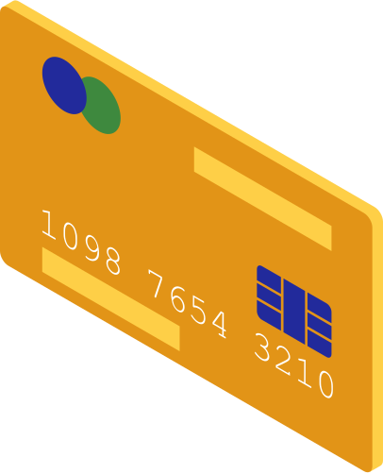
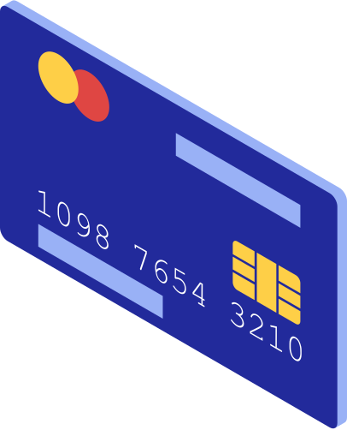
Cypress Real-World App
Full-featured web application designed for managing day-to-day financial transactions. It offers a smooth and intuitive user experience
Key Features for Users
01 | Create an Account and securely log in.
02 | Send and Receive Payments easily between users.
03 | Track Transaction History to stay on top of their finances.
04 | Manage Contacts for quick and hassle-free transfers.

Slide 4
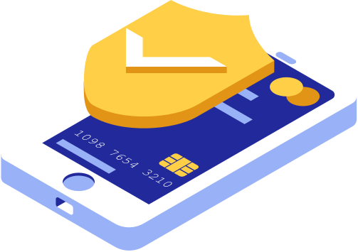
Technologies Used in the Website
Frontend | React: For building a dynamic, interactive user interface.
Frontend | Material-UI: A library of pre-built, styled components for a modern and consistent look.
Frontend | TypeScript: Adds type safety to JavaScript, ensuring fewer bugs and improved development efficiency.
Backend | Express.js: A fast and lightweight web framework for handling API requests and server-side logic.
Backend | lowdb: A local JSON-based database for storing data, eliminating the need for a full-fledged database system
Additional Tools | Node.js: Powers the backend with JavaScript, enabling efficient server-side operations.
Additional Tools | Yarn: Manages dependencies and builds the project efficiently.

Slide 5
Project Overview
User Authentication: Verifying secure login and account access.
Transaction Functionality: Ensuring smooth creation, sending, and tracking of payments.
Cross-Browser Compatibility: Testing consistent performance across Chrome and Edge.
Notifications: Ensuring timely and accurate user alerts for key events.

Slide 6






Development Tools
VS Code: Used as the main code editor for writing, debugging, and testing the scripts. GitHub: For version control and collaboration, allowing seamless management and sharing of code.
Testing Tools
Selenium IDE: Used for recording initial test flows and understanding application behavior before coding the tests. Selenium WebDriver: Automates the browser interactions for robust and repeatable testing. Pytest: A framework for writing simple and scalable test cases. Pytest HTML: Generates detailed test reports for analysis.
Supporting Libraries
WebDriverWait: Works with EC to manage dynamic element interactions. ActionChains: Handles advanced user interactions like drag-and-drop or hover effects. Keys: Simulates keyboard inputs for testing. expected_conditions (EC): Simplifies waiting for specific conditions or states of web elements, such as visibility or clickability.
Technologies Used

Slide 7
Functional
Tests
Non-Functional
Tests
Login Functionality
Transaction Management
Notifications
Form Validations
Cross-Browser Compatibility
Performance Testing
UI/UX Consistency

Slide 8
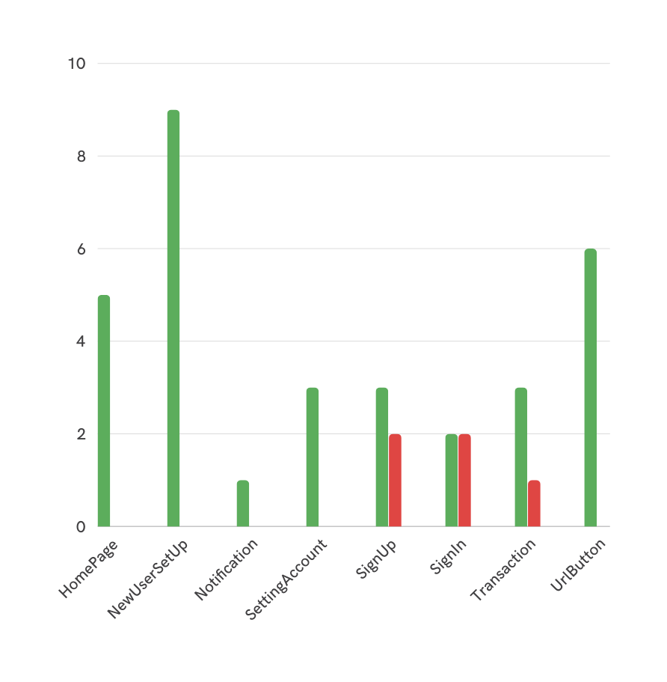
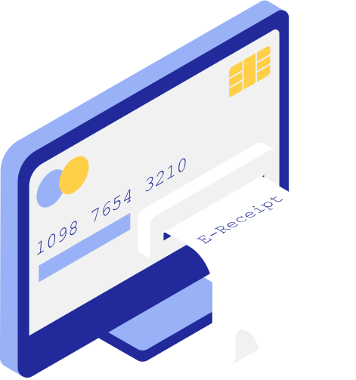
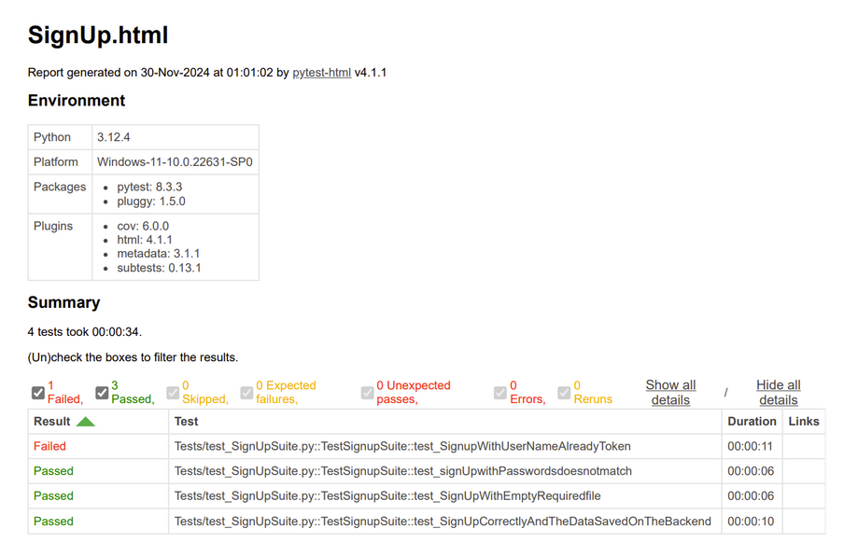
Test Results

Slide 9

THANK YOU
Q & A

